Slide 1
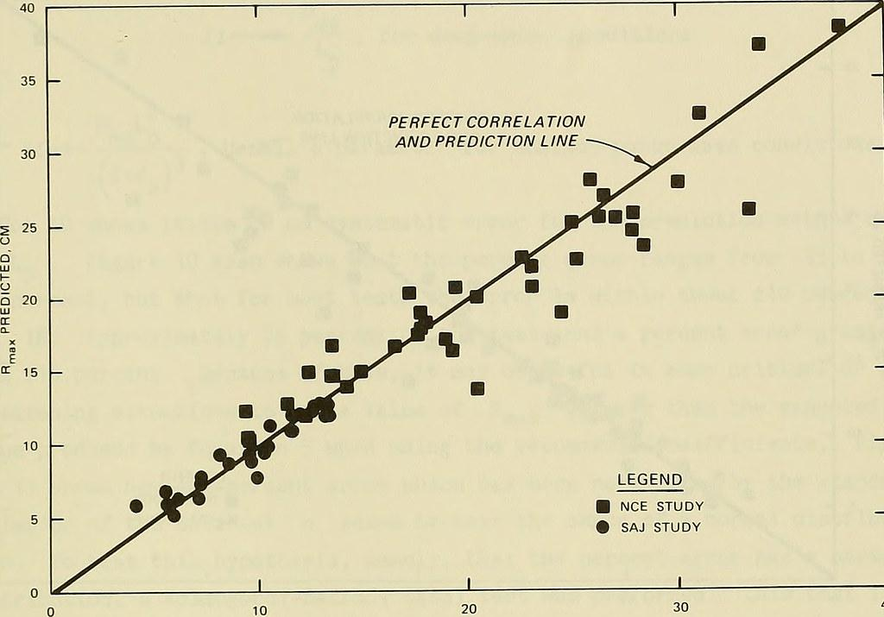
Case Project
Facebook Live Sellers & Sales Prediction

Slide 2
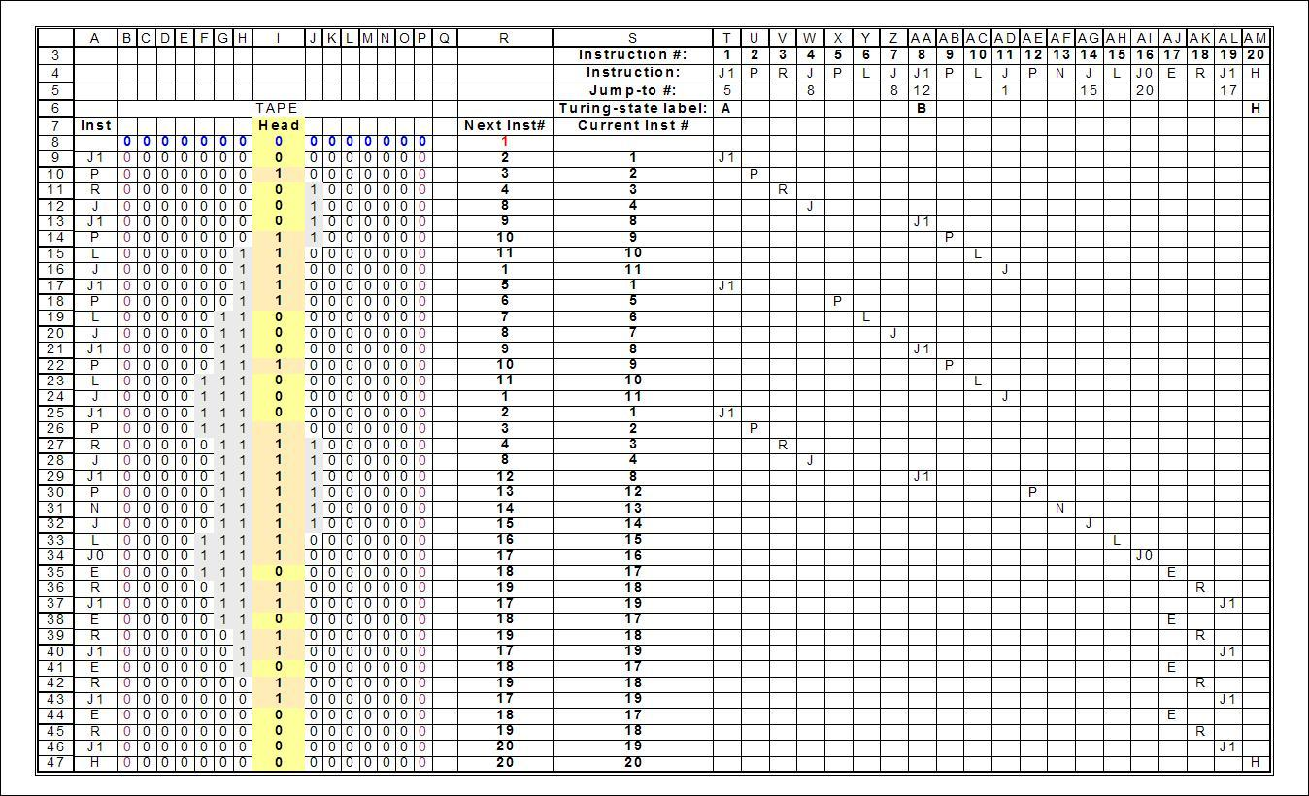
The Datasets
Facebook Live Sellers Dataset The Facebook Live Sellers in Thailand dataset contains information about the Facebook pages of 10 Thai fashion and cosmetics retail sellers.
Sales Prediction Dataset The dataset provided contains information about the advertising expenditures of a company on various platforms (TV, Radio, newspapers) and the corresponding sales of a product.

Slide 3
Facebook Live Sellers

Slide 4
Description of the Dataset
The dataset contains the following columns:
- status_id: Unique identifier for each status post.
- status_published: Date and time when the status post was published.
- status_type: Nature of the status post (e.g., video, photo, status, link).
- num_reactions: Number of reactions (e.g., likes, loves, wow, haha, sad, angry) received on the status post.
- num_comments: Number of comments received on the status post.
- num_shares: Number of shares received on the status post.
- Additional numerical and categorical attributes related to engagement metrics and status post features.
- There are also four columns which are all empty.

Slide 5
Problem Statements
1. How does the time of upload (`status_published`) affect the `num_reaction`?
2. Is there a correlation between the number of reactions (num_reactions) and other engagement metrics such as comments (num_comments) and shares (num_shares)? If so, what is the strength and direction of this correlation?
3. Use the columns status_type, num_reactions, num_comments, num_shares, num_likes, num_loves, num_wows, num_hahas, num_sads, and num_angrys to train a K-Means clustering model on the Facebook Live Sellers dataset.
4. Use the elbow method to find the optimum number of clusters.
5. What is the count of different types of posts in the dataset?
6. What is the average value of num_reaction, num_comments, num_shares for each post type?

Slide 6
Data Preprocessing
Loaded the Dataset I read the Facebook_Marketplace_data.csv file into a Pandas DataFrame (dataset).
Checked for Missing Values I used .isnull().sum() to identify the number of missing values in each column.
Dropped Unnecessary Columns I removed four columns (Column1, Column2, Column3, and Column4) because they were empty.
Converted status_published Column I converted the third column into a datetime using pd.to_datetime().

Slide 7
Extracted Hour from status_published Column I created a new column hour_published by extracting the hour from the datetime column.
Dropped the Original status_published Column After extracting the hour, I removed the original status_published column.
Encoded Categorical Data I applied LabelEncoder from sklearn.preprocessing to transform the status_type column into numerical values.
This preprocessing ensures that my dataset is cleaned, relevant columns are retained, and categorical data is converted into a machine-readable format.

Slide 8
Relationship between time of upload & number of reactions
Grouped Data by Hour I used .groupby("hour_published") to group posts based on the hour they were published.
Calculated Average Reactions I computed the mean number of reactions (num_reactions) for each hour using .mean().
Analyzed Trends This approach helped identify peak hours when posts tend to get more engagement.

Slide 9
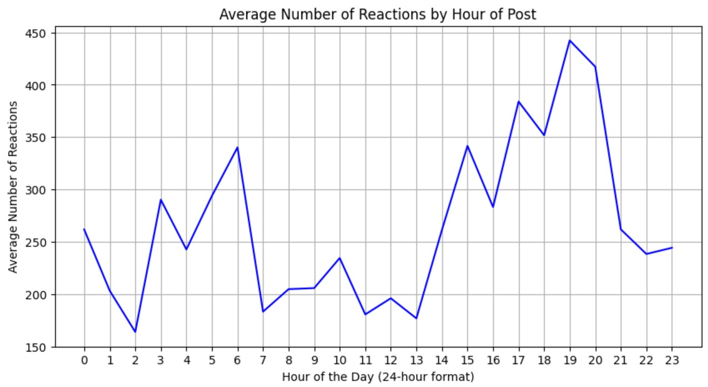
The Trend Plot

Slide 10
Correlation between the number of reactions and other engagement metrics
Selected Relevant Columns I extracted only num_reactions, num_comments, and num_shares from the dataset.
Computed Correlation Matrix I used .corr() to calculate the Pearson correlation coefficients between these three variables.
Interpreting Correlation A positive correlation (close to 1) means that as one variable increases, the others tend to increase. A negative correlation (close to -1) means that as one variable increases, the others tend to decrease. A correlation close to 0 suggests no strong relationship between the variables.

Slide 11
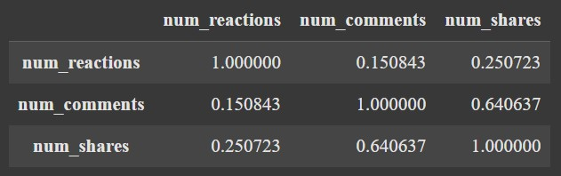
The Correlation Matrix

Slide 12
K-Means clustering model & Elbow Method
Imported Necessary Libraries KMeans from sklearn.cluster for clustering. matplotlib.pyplot for visualization.
Prepared Data for Clustering Selected numerical features. These variables were chosen because they represent engagement metrics and could help group similar posts.
Used the Elbow Method to Determine the Optimal Number of Clusters Initialized an empty list wcss to store the Within-Cluster Sum of Squares (WCSS) for different cluster counts. Ran a loop from 1 to 10, where for each i: A K-means model was created with n_clusters=i. The model was fitted to the dataset. The inertia (sum of squared distances from points to their cluster centers) was calculated and stored.

Slide 13
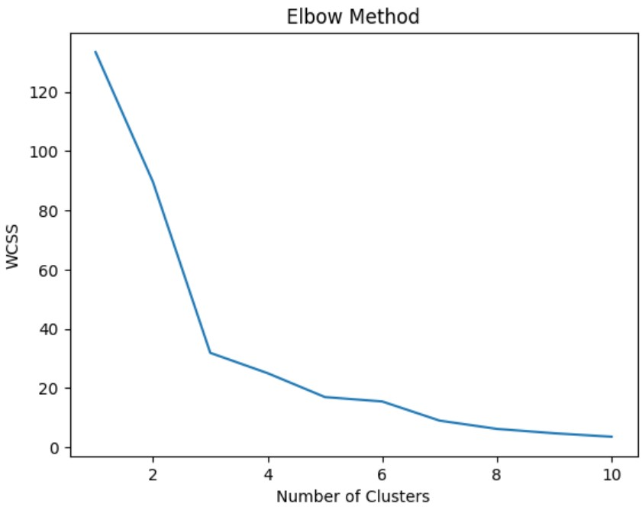
Visualized the Elbow Method Graph Plotted the WCSS values against the number of clusters. The "elbow point" in the graph helps identify the optimal number of clusters.
Optimal number of clusters was found to be 3.

Slide 14
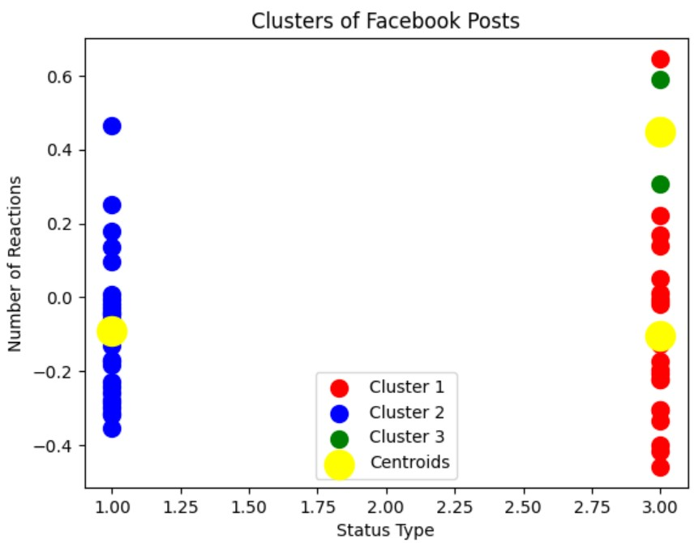
The Model’s Visualization

Slide 15
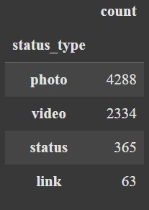
Count of different types of posts in the dataset
Loaded the Dataset I read the dataset into a Pandas DataFrame.
Counted Unique Post Types I used .value_counts() on the status_type column to count the
occurrences of each type of post.
Displayed the Count of Each Post Type
This showed the number of occurrences for each post type.

Slide 16
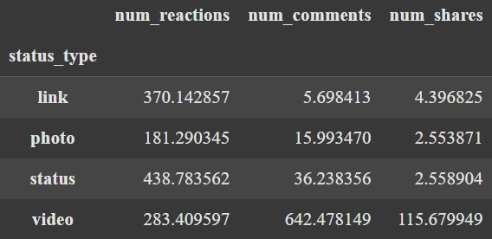
Average value of num_reaction, num_comments, num_shares for each post type
Grouped Data by status_type
I used .groupby("status_type") to categorize posts based on their type. Selected the numerical columns: num_reactions (likes, loves, etc.) num_comments (user comments) num_shares (times the post was shared) Applied .mean() to compute the average engagement for each post type.
Displayed the Results
This showed the average number of reactions, comments,
and shares for each post type.

Slide 17
Sales Prediction

Slide 18
Description of the Dataset
The dataset contains the following columns:
TV: This column represents the amount of money spent on advertising the product on television. TV advertising is a traditional and widely used medium for reaching a broad audience.
Radio: This column indicates the advertising expenditure on radio. Radio advertising is known for its ability to target specific demographics and local audiences.
Newspaper: This column shows the advertising cost spent on newspaper advertising. Newspaper advertising is often used for targeting specific geographic regions or demographics.
Sales: This column represents the number of units sold corresponding to the advertising expenditures on TV, Radio, and newspapers.

Slide 19
Problem Statements
1. What is the average amount spent on TV advertising in the dataset?
2. What is the correlation between radio advertising expenditure and product sales?
3. Which advertising medium has the highest impact on sales based on the dataset?
4. Plot a linear regression line that includes all variables (TV, Radio, Newspaper) to predict Sales, and visualize the model's predictions against the actual sales values.
5. How would sales be predicted for a new set of advertising expenditures: $200 on TV, $40 on Radio, and $50 on Newspaper?
6. How does the performance of the linear regression model change when the dataset is normalized?
7. What is the impact on the sales prediction when only radio and newspaper advertising expenditures are used as predictors?

Slide 20
Data Preprocessing
Checking for Missing Values
I checked the dataset for missing values in each column using .isnull().sum(). This helped identify columns that required cleaning.
Handling Missing Values (Imputation)
I found that the Radio column had missing values. To handle this, I used SimpleImputer(strategy='mean') to replace missing values with the mean of the column. After imputation, I rechecked for missing values.

Slide 21
Average amount spent on TV advertising
Calculated the Mean Value
I extracted the TV column from the dataset, which represents the amount spent on TV advertisements. Used .mean() to compute the average spending on TV ads. Printed the result to see the average amount.
The average was found to be 147.0425.

Slide 22
Correlation between radio advertising expenditure and product sales
Correlation Calculation:
I computed the correlation coefficient between "Radio" and "Sales". This measures the strength and direction of the relationship between radio ad spending and product sales.
It was found out to be 0.3496507429302875.

Slide 23
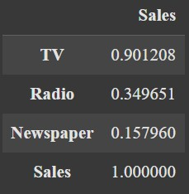
Advertising medium that has the highest impact on sales
Correlation Analysis:
I computed the correlation matrix to determine how strongly each advertising medium (TV, Radio, Newspaper) correlates with sales:
This helped assess which medium had the strongest linear
relationship with sales.
From the correlation matrix, we see that TV has the highest
impact on sales.

Slide 24
Linear Regression Model
Defining Features and Target Variable
I selected independent variables (advertising mediums) and the dependent variable (sales).
Splitting Data into Training and Testing Sets
To train and evaluate the model, I split the dataset.
80% of data was used for training. 20% of data was used for testing.

Slide 25
Training the Multiple Linear Regression Model
I initialized and trained the regression model.
The model learned the relationship between advertising spend (TV, Radio, Newspaper) and sales.
Making Predictions on Test Data
Once the model was trained, I used it to predict sales on unseen test data.
Evaluating Model Performance
I compared actual vs. predicted sales using a scatter plot:
A red diagonal line represents perfect predictions. The blue scatter points show how close the actual sales values are to the predicted ones.

Slide 26
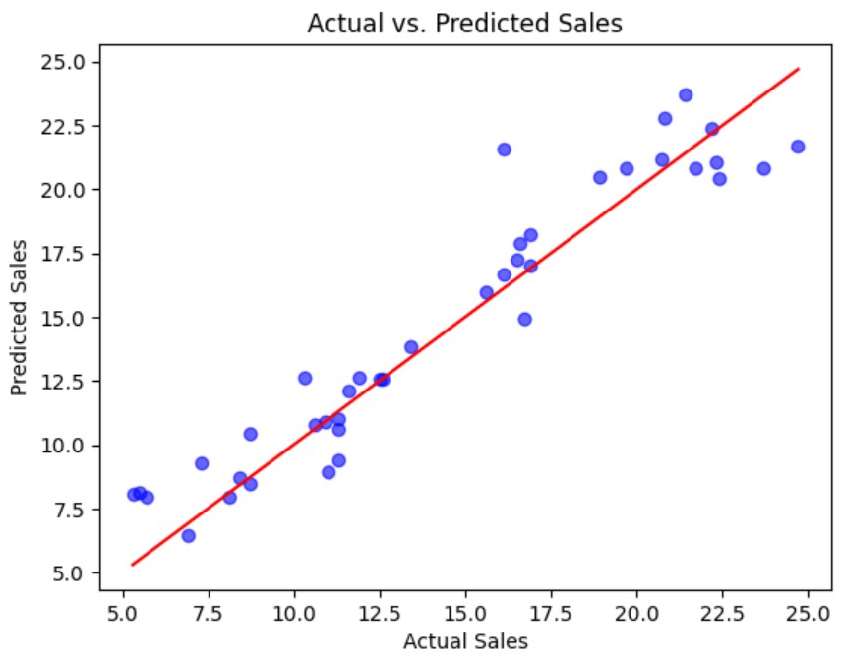
The Model’s Visualization

Slide 27
Sales predicted for a new set of advertising expenditures
To test the model, I predicted sales for a specific ad budget:
This estimated sales based on $200 spent on TV, $40 on Radio, and $50 on Newspaper.
The predicted sales were found to be $19.81151092944479.

Slide 28
Linear Regression Model when the dataset is normalized
To improve model performance, I applied feature scaling by using standardization. This standardized the data to improve model accuracy.
For this case, standardization did not impact the performance because the model was not sensitive to feature scaling. So, there was no difference in the models.

Slide 29
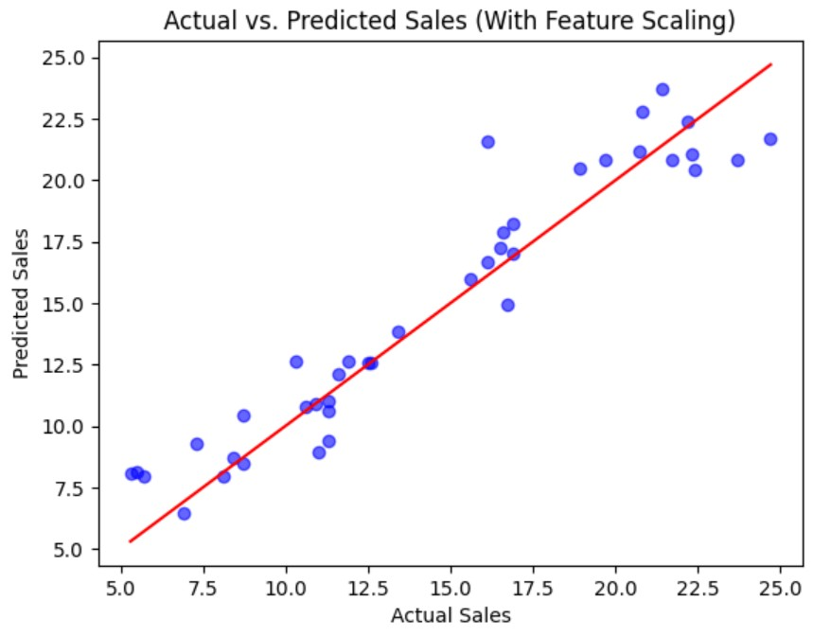
The Model’s Visualization

Slide 30
Linear Regression Model when the dataset is reduced
I tested the model by removing TV ads to see how "Radio" and "Newspaper" alone influenced sales. Using only Radio and Newspaper as predictors reduces model accuracy compared to using all three (“TV”, “Radio”, and “Newspaper”).

Slide 31
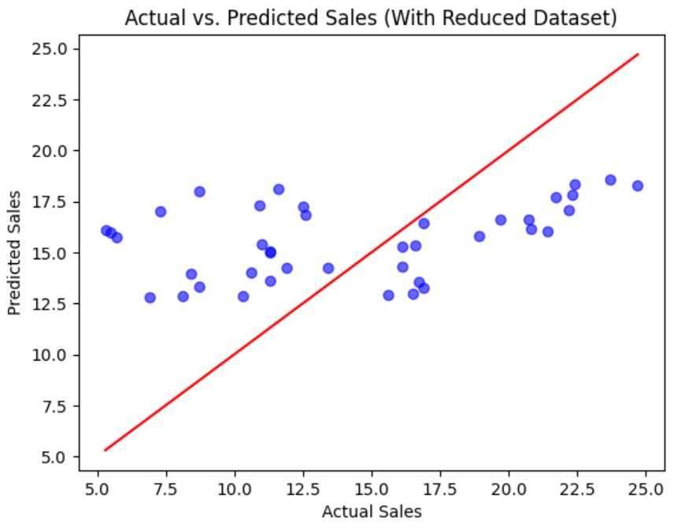
The Model’s Visualization

Slide 32
Thank You

